Slide 1
HASH ANALYTICS PROJECT PRESENTATION FOR THE 2020 INTERNSHIP PROGRAM at
HASH ANALYTICS INFORMATION TECHNOLOGY & SERVICES
(Glasgow, Scotland)
By
EMMANUEL OYEDEJI
2020 INTERN

Slide 2
ANALYSIS OF COMPANY X EMPLOYEE ATTRITION
Employee Attrition refers to the loss of employees through a natural process, such as retirement, resignation, elimination of a position, personal health, or other similar reasons resulting in reduction in size and strength of workforce, at the same time, job duties could increase the work load for remaining employees. Which can consequently result in low productivity of the company.
To investigate the reasons for attrition in Company X, these important questions must be asked by their employer:
1. Why Employees are prone to leave the company?
2. What type of Employees are leaving?
3. Which employee is prone to leave the company next?
This questions can be addressed by examining the record of employees contained in the dataset and also applying machine learning to predict churning of other employees, which will ultimately help the employer take drastic steps to tackle attrition of his workers.

Slide 3
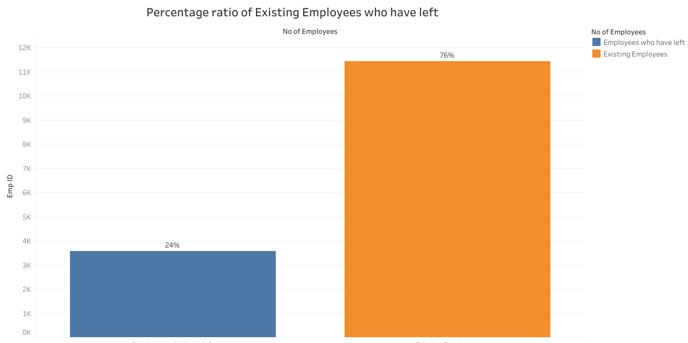
Dataset of Employees
In the Employees Dataset of Company X given, there are two datasets;
a. Existing Employees dataset which has 11,428 samples and 10 attributes
b. Employees that have left dataset which has 3571 samples and 10 attributes.
(The dataset has a total of 14,999 samples, and 10 each attributes)

Slide 4
Why Employees are prone to leave the company and what type of Employees are leaving?
These Methodologies can be employed to analyse Company X attrition Case;
Data Exploration and Visualization ( Using Tableau) :This technique is very useful in answering the question ‘Why employees are prone leave the company? and What type of employees are leaving?
Building a Machine learning prediction Model( Using Python): This approach interestingly predicts the exact employees that are prone to leave next.

Slide 5
1. DATA EXPLORATION AND VISUALIZATION (USING TABLEAU)
The exploration and visualization of the employees dataset is one of the effective way of having a big picture of the factors leading to the increase in employee’s attrition rate.
In examining this, It is essential to look into the employee’s dataset(both existing and ex-employee’s ),comparing the two datasets base on the given attributes using charts and telling stories from the visualized charts.
To achieve this, I determined the relationship between the two datasets with the aid Tableau charts. With Tableau, I was able to visualize, tell story and have insight into the approximately 15000 employee’s data base on the following attributes:
‘satisfaction_level’, ‘last_evaluation’, ‘number_project’,
‘average_montly_hours’, ‘time_spend_company’, ‘Work_accident’,
‘promotion_last_5years’, ‘Departments’, ‘salary’

Slide 6
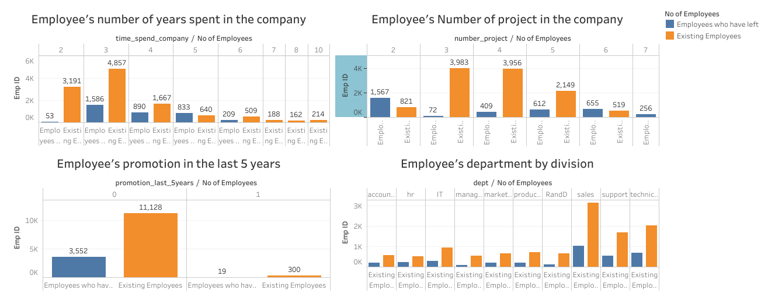
Why Employees are prone to leave the company and what type of Employees are leaving?

Slide 7
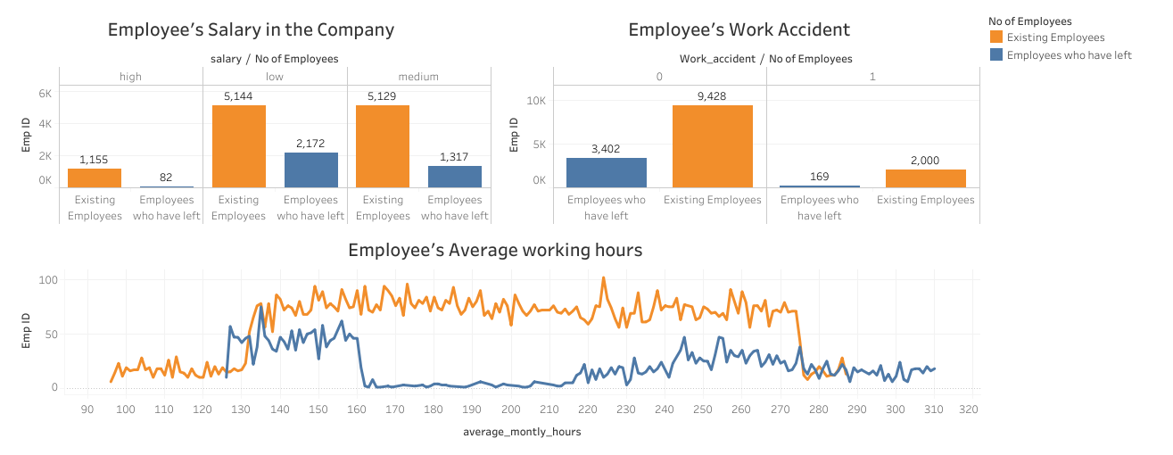

Slide 8
From the visualizations above, it is evident that;
Employees that have spent 5 years in the company seems to leave more compared to other working years. Probably because a decidedly less number of employees have gotten promotion in the last 5 year.
Those employees who have a low number of projects of 2 left the company more.
The employee who had done 6 and 7 projects, left the company it seems to like that they were overloaded with work.
The sales department is having maximum number of existing employees. It also has the highest churning of employees.
Most of the employees are getting salary either medium or low.
All employees with working hours above 285hours left while most employees with moderate working hours are not leaving.
Those who promotion in last 5 years they didn't leave, i.e., all those that didn't get the promotion in the previous 5 years left.
Few employees experienced work accidents

Slide 9
2. Building a Machine learning prediction Model( Using Python) Which employee is prone to leave the company next?
To predict the employees that are prone to leave next requires the application machine learning. This involves building a predictive machine learning model by training it using relevant data and testing the performance of the model.
The below are the step-by-step techniques I used in predicting the list of employees that are prone to leave:
1. Extracting the 3571 datasets of employees who have left and assigning a target value of ‘1’ to every rows in the sample.
2. From the 11,428 samples of the existing employee datasets, I grouped this dataset into three clusters base on employee’s satisfaction level and last evaluation using cluster analysis in python.

Slide 10
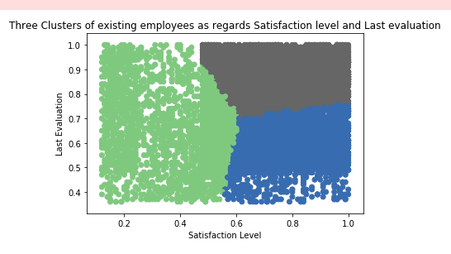
High Satisfaction level and High Evaluation(Shaded grey in the graph): These employees would most likely stay in the company because of the affection for their Job.
High Satisfaction and less Evaluation(Shaded Blue in the graph): These employees are less likely to stay.
Low Satisfaction and moderate Evaluation (Shaded green in the graph): These employees won’t likely be staying.

Slide 11
3. Since the most important factor for any employee to stay or leave is satisfaction level and performance in the company. From the 3 clusters of existing employees, high satisfaction and high performance employees would most likely not leave the company. So, I extracted this set of employee’s datasets (containing 1584 samples) and assign a target value of ‘0’ to every rows in the sample.
4. Having assigned target values(output) to the two classes of dataset(Ex-employees and employees with high level of satisfaction and performance), I then concatenated the two dataframes using pandas library (This gave a total of 5155 employees)
5.The new 5155 datasets containing 10 feature names( which are the attributes) with target values of ‘0’ (staying) and ‘1’ (leaving) was then cleaned and preprocessed before fitting into the machine learning algorithm.

Slide 12
6. I then tested and trained the new data using KNN algorithm(I chose the best K by iterating K values from 1 to 50)
7. After Validation and building a machine learning model from the new 5155 datasets. I then fit the datasets of other existing employees( employees with low satisfaction level an low performance & employees with moderate satisfaction and performance) into the built machine learning model.
The model predicts 3569 employees which are prone to leave. I then used Tableau to better visualize it.

Slide 13
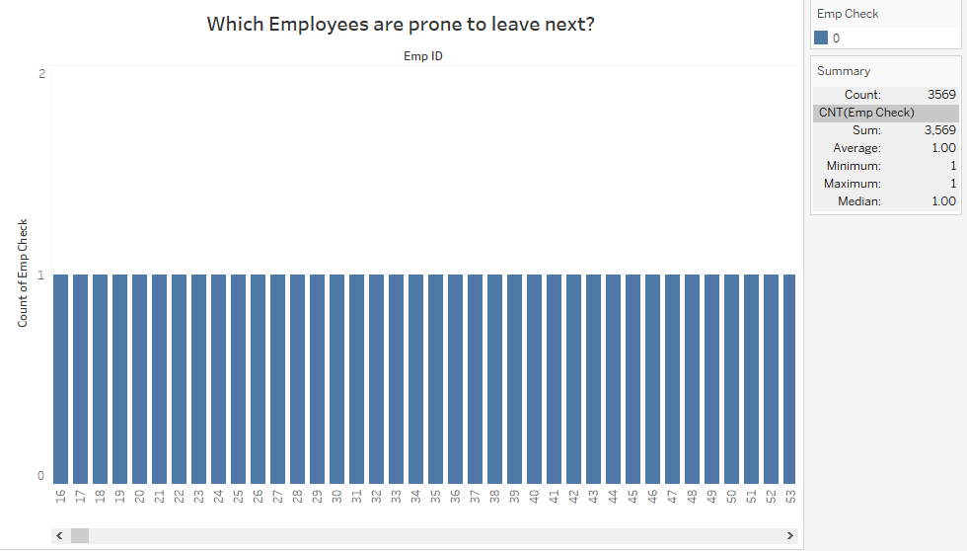
Visualization showing which employees is prone to leave next

Slide 14
THANK YOU

